Slide 1


Computer
Lecture 13
Dr. Nada Abdullah Rasheed
Assist prof. / Computer Science

Slide 2
Syllabus Content
Subject | Lec. No.
Definition of Computer | 3
History of Computers | 5

Slide 3
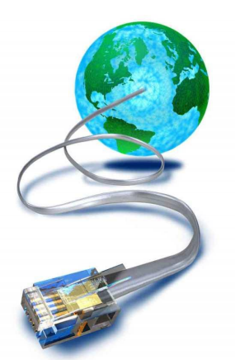
Chapter Six
Internet and Intranet
6.1 The Internet
• A global network connecting millions of computers.
• More than 100 countries are linked into exchanges of data, news and opinions.
• The Internet links are computer networks all over the world so that users can share resources and communicate with each other.

Slide 4
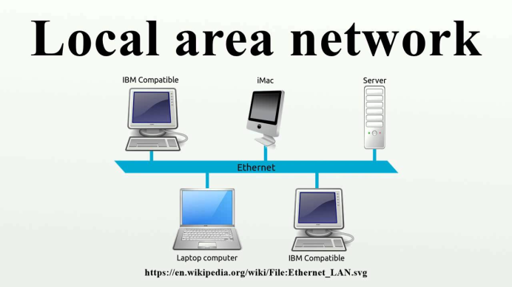
6.2 Types of Computer Network
Local Area Network (LAN)
• A LAN connects network devices over a relatively short distance.
• A networked office building, school, or home usually contains a single LAN, though sometimes one building will contain a few small LANs (perhaps one per room), and occasionally a LAN will span a group of nearby buildings.

Slide 5
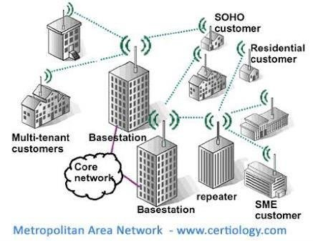
Metropolitan Area Network (MAN)
• A metropolitan area network (MAN) is a large computer network that usually spans a city or a large campus.
• A MAN often acts as a high speed network to allow sharing of regional resources.
• A MAN typically covers an area of between 5km and 50km diameter.
• A MAN might be owned and operated by a single organization, but it usually will be used by many individuals and organizations

Slide 6
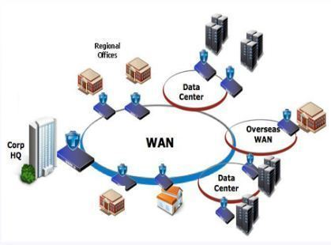
Wide Area Network (WAN)
• WAN covers a large geographic area such as country, continent or even the whole of the world.
• A WAN is a geographically-dispersed collection of LANs.
• Most WANs (like the Internet) are not owned by any one organization but rather exist under collective or distributed ownership and management.

Slide 7
6.3 Internet Access
• To gain access to the internet, the user has to register to any Internet Service Provider (ISP).
• Types of Internet connection: – Dail-up – Integrated services digital network – Asymmetric Digital Subscriber Line – Wireless Internet Connections – Internet over Satellite

Slide 8
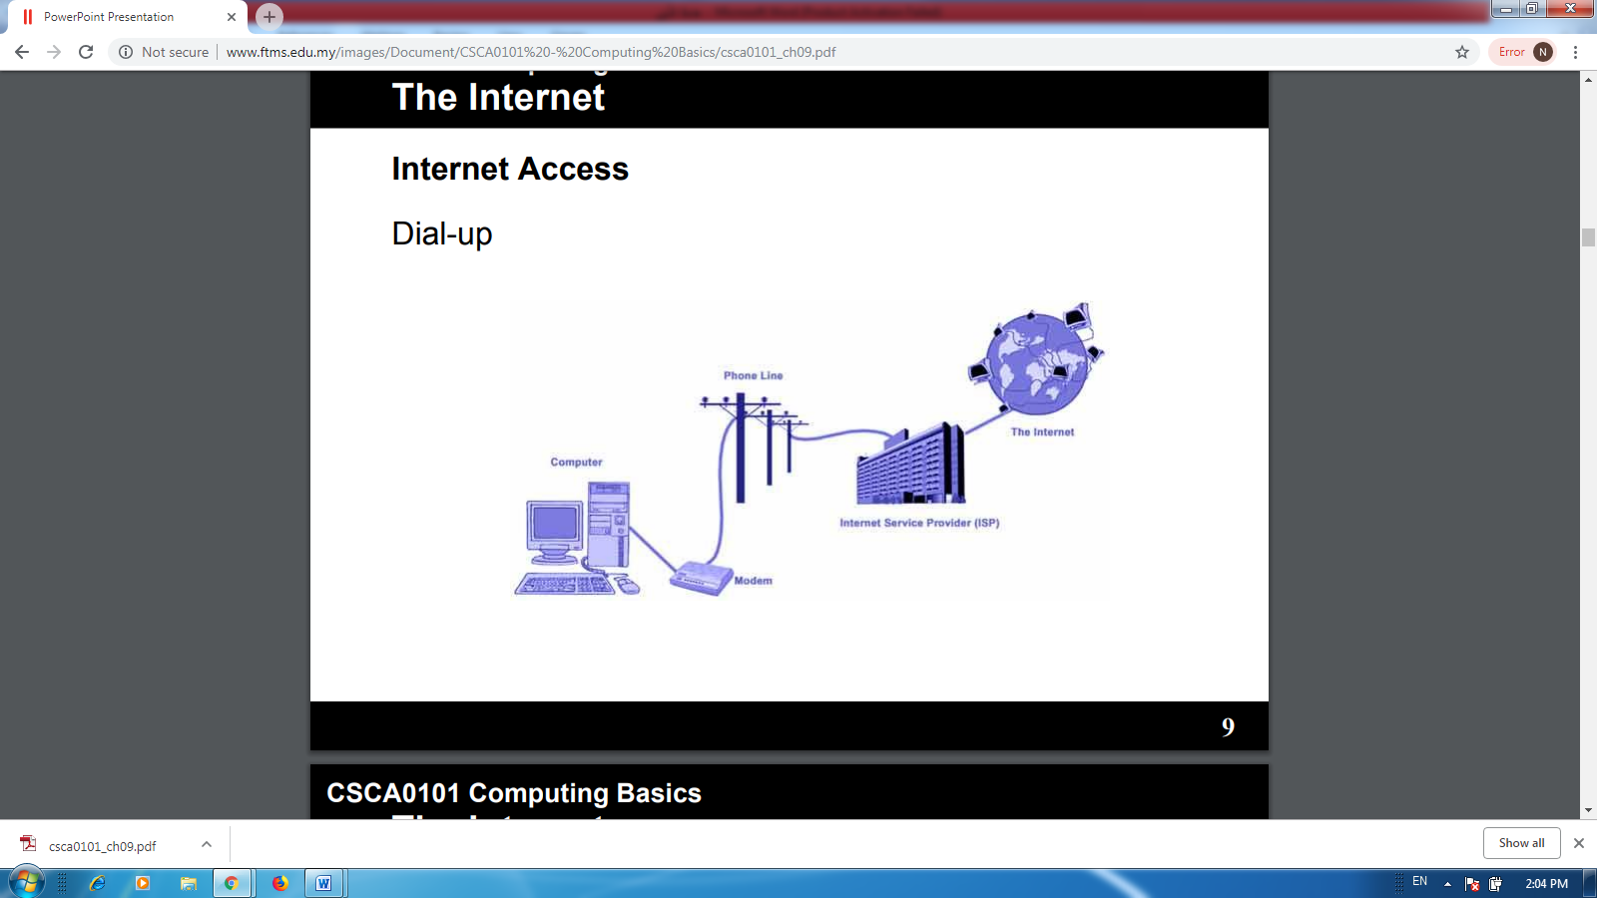
Dial-up
• Slower that other type of connection.
• Connects through existing phone lines using dial-up modem.
• Cheapest.
• Must “dial-up” to connect to the Internet and disconnect when done.
• Cannot use the Internet and phone line at the same time.

Slide 9
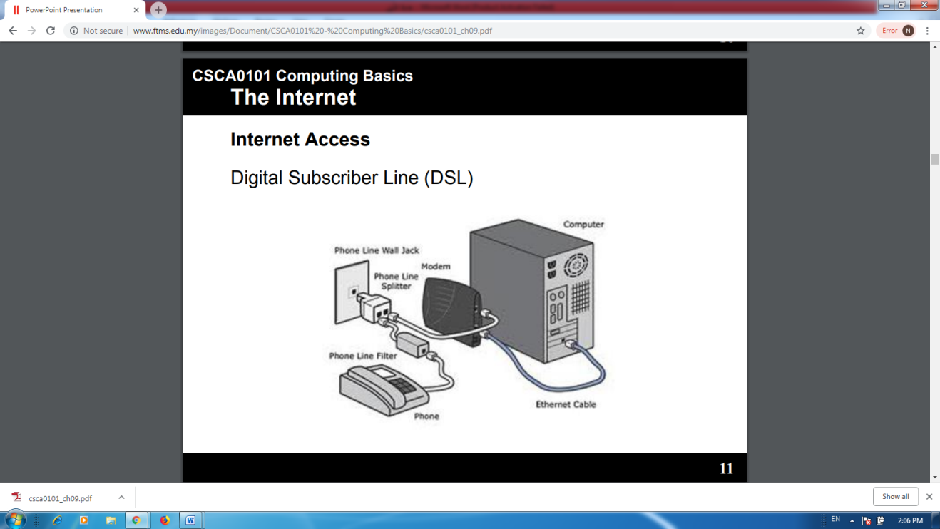
Digital Subscriber Line (DSL)
• Broadband – faster than dial-up connection.
• Connects through phone lines, but does not require phone service.
• Always on.
• Internet and phone can be used in the same time.
• Unavailable in many locations.

Slide 10
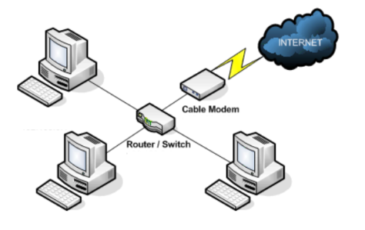
Cable
• Broadband – faster than dial-up and DSL.
• Use cable connection.
• Always on.
• Only available where cable is available.

Slide 11
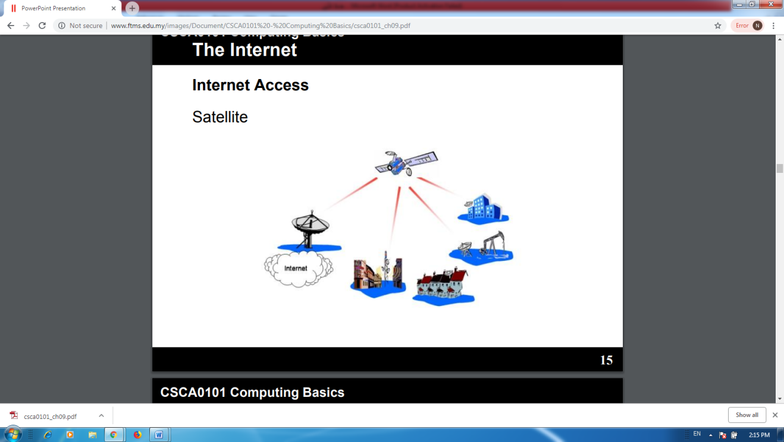
Satellite
• Broadband – faster than dial-up, but data is delayed.
• Connects via satellites.
• Can be affected by rain and snow.
• Does not require phone lines and cables.
• Can be used anywhere around the world.

Slide 12
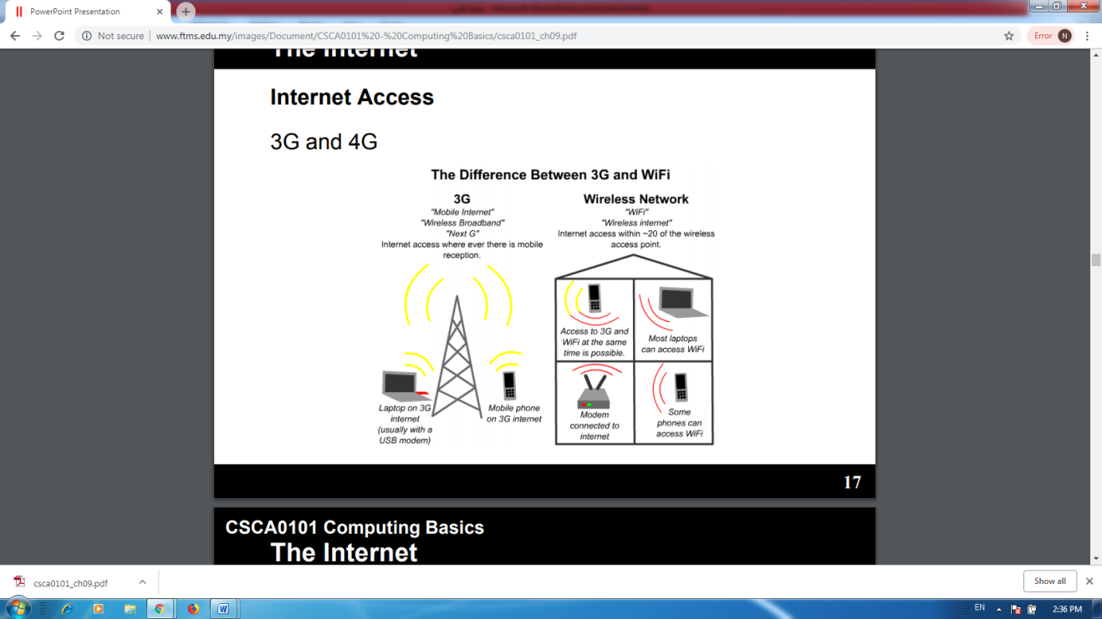
3G and 4G
• Available for mobile phones, computers and tablets.
• Connects wirelessly through 3G/4G provider.
• Can access Internet anywhere.
• Slower than DSL and Cable connection.

